Slide 1

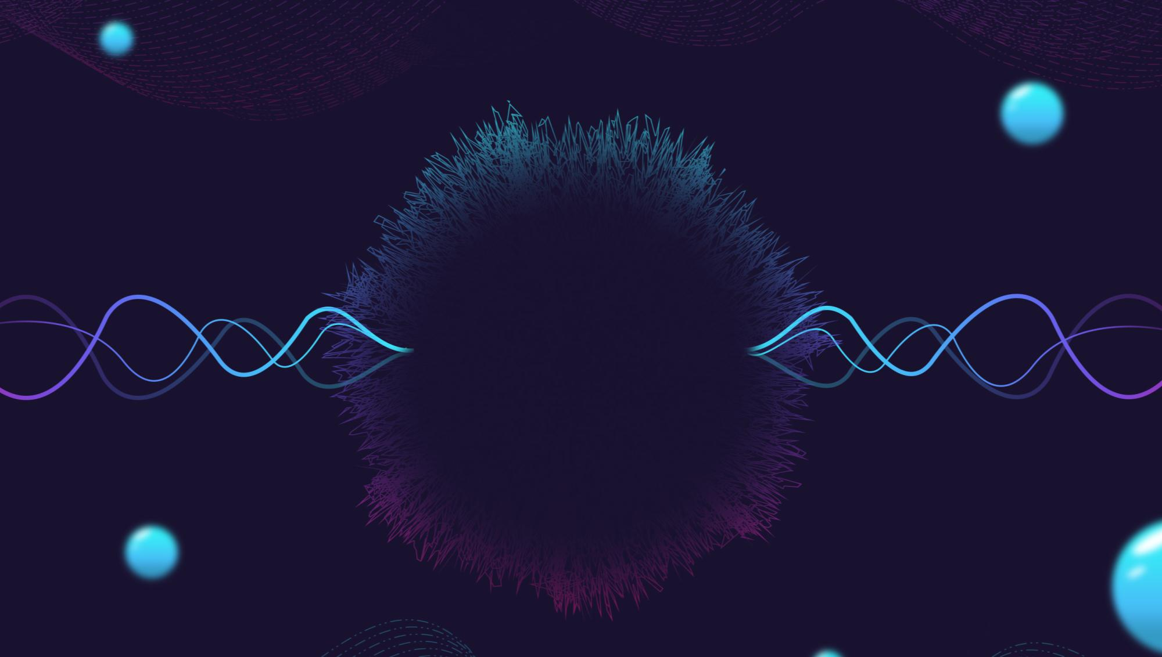
WRITE A TITLE IN THIS SECTION
Final project
年终报告
Data Analysis
By faith I mean a vision of good one cherishes and the enthusiasm
that pushes one to seek its fulfillment regardless of obstacles.
Group 5
设计师：梦想PPT 部门：营销部
BI XIAOYANG
WANG QIPENG
ZHANG YICHI
HU YAQI
AIT2009357(Leader) AIT2009376(Presenter)AIT2009380
AIT2009364

Slide 2
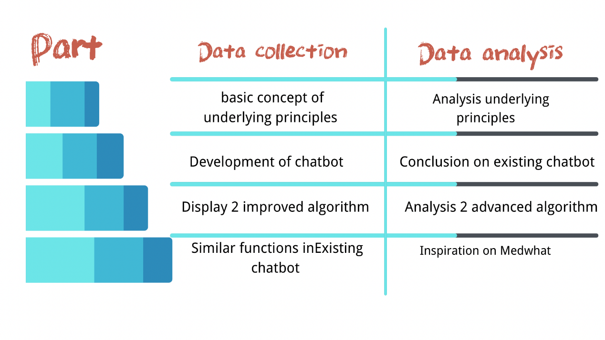
INTRO
We proceeded to conduct a detailed analysis of these materials, which allowed us to adapt them to our project more specifically.
Questions after data collection:
1.What are the principles of these algorithms？
2.Why are we choosing these algorithms?
3.How would we apply them into our chatbot?

Slide 3
TABLE OF
Part I
Analysis about drawing a conclusion on their advantages and disadvantages of them.
1
2
Part II
a heated discussion on all the principles being applied in our chatbot
3
Part III
define the scope of our chatbot and analyze the chatbot Medwhat
CONTENTS
4
Reference

Slide 4
01
PART I

Slide 5

Part I
In this part we will focus on discussing their advantages and disadvantages.
In this part, the most important references are from article Sequence to Sequence Model Performance for Education Chatbot. It shows the latest development of Seq2seq chatbot’s application in certain field.

Slide 6
Advantages
(1)Capture long-distance dependencies. Seq2Seq chatbot is more capable of linking up memories than traditional chatbots. The low-level CNN captures the dependencies between words that are closer together, and the RNN captures the dependencies between words that are farther away. Through the hsierarchical structure, a function similar to high-level CNN to capture the dependencies of sequences with a length of more than 20 words could be realized.

Slide 7
Advantages
(2)Various functions based on different models. For different tasks, adjustments are usually made to the RNN model structure, which is divided into three more common structures depending on the number of inputs and outputs: N vs N, 1 vs N, and N vs 1.

Slide 8
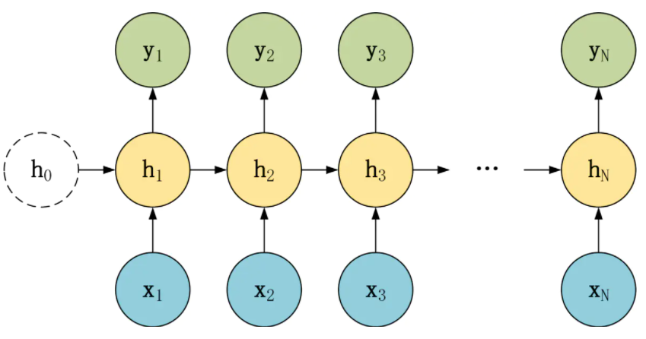
N vs N structure

Slide 9
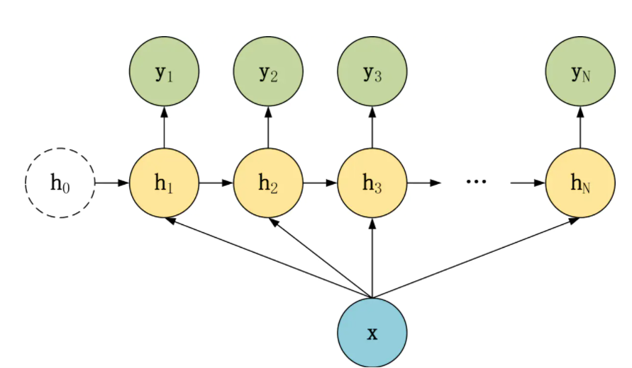
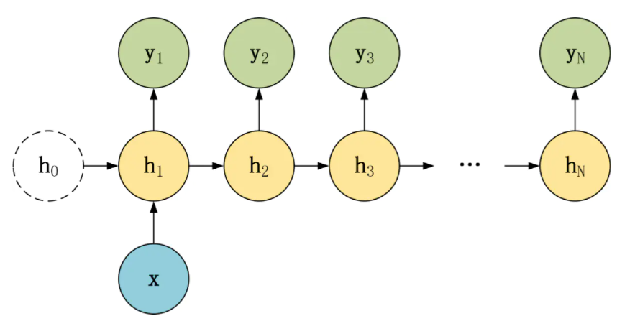
1 vs N structure

Slide 10
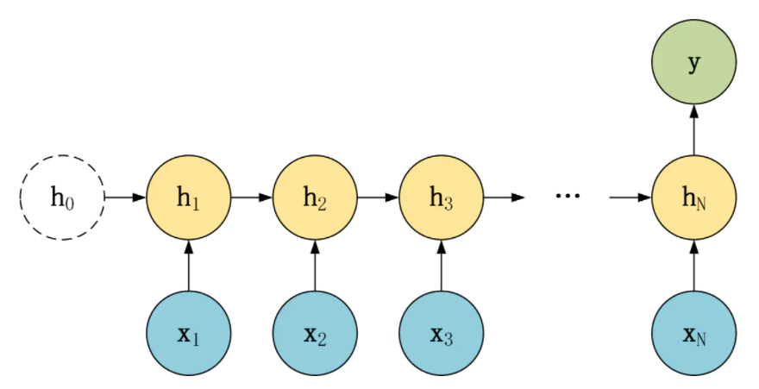
N vs 1 structure

Slide 11
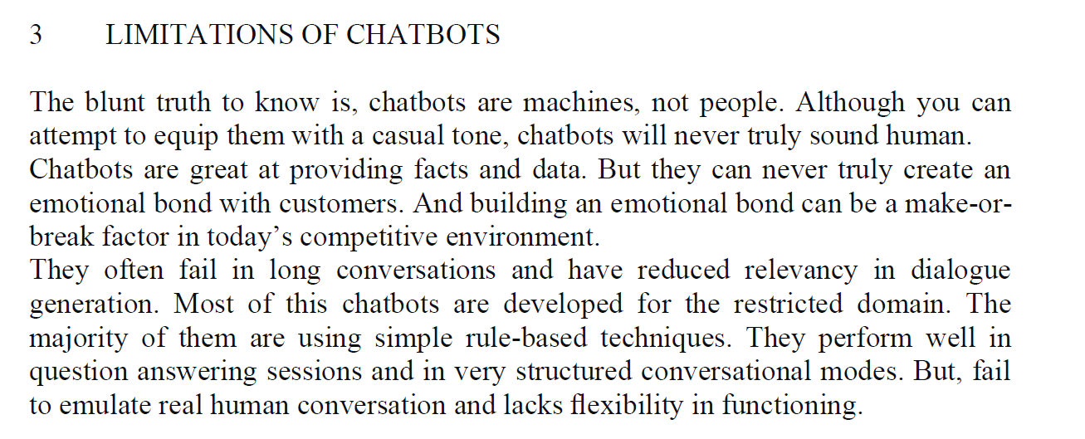
Disadvantages
(1)Low efficiency. Assuming that a sequence has a length of n, modeling it using RNN (LSTM) requires n operations, and the time complexity is O(n). In contrast, the use of stacked CNN, another kind of Neural network, only requires n/k operations, and the time complexity is O(n/k), where k is the convolution window size.

Slide 12
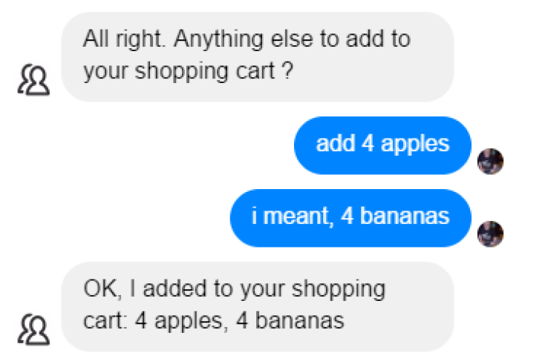
Disadvantages
(2)Failure in long conversation
They often fail in long conversations and have reduced relevancy in dialogue generation. This can be shown well in the following figure.

Slide 13
02
Part II

Slide 14
Questions
1.What are the principles of these techniques？
2.Why are we choosing these algorithms?
3.How would we apply them into our chatbot?

Slide 15
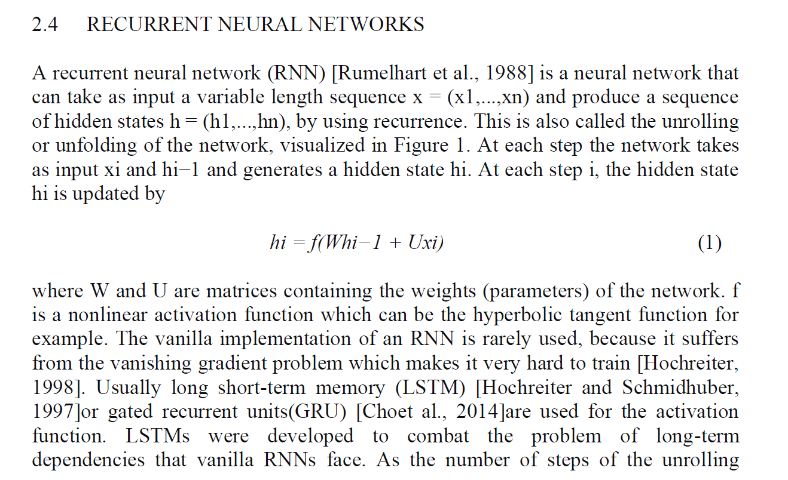
Part II
Recurrent neural networks are an important branch of neural networks, and our understanding of the importance of recurrent neural networks can start from our knowledge of ordinary neural networks

Slide 16
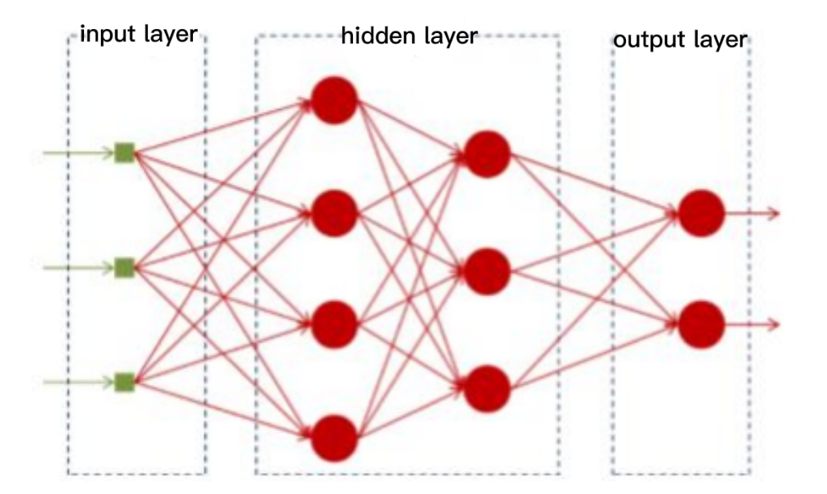
Recurrent Neural Network (RNN)
A neural network can be treated as a black box capable of fitting any function, and given enough training data, given a specific x, the desired y can be obtained, and the structure diagram is as follows

Slide 17

Recurrent Neural Network (RNN)
E.g:
We can play a game with a computer where we write some words in front of a sentence, and then, have the computer write the next one for us.

Slide 18
Recurrent Neural Network (RNN)
Language modeling is the modeling of features of a language, and it has many uses. For example, in speech-to-text (STT) applications, the output of an acoustic model is often a number of possible candidates, and then a language model is needed to select the most likely one from these candidates.

Slide 19

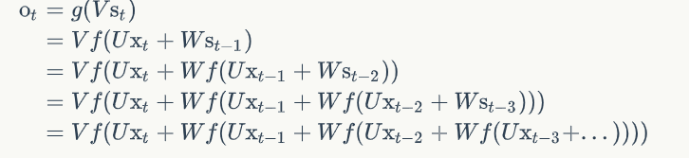
Recurrent Neural Network (RNN)
If we repeatedly bring equation 2 to equation 1, we will get
Here is the 2 formula used :

Slide 20
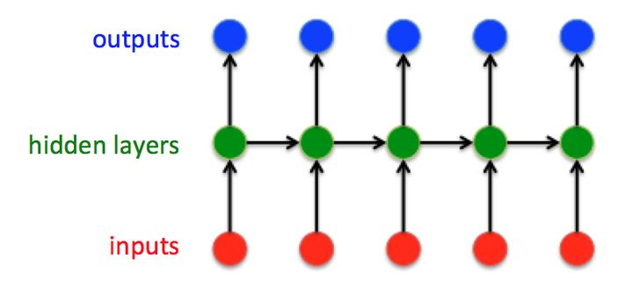
Recurrent Neural Network (RNN)
Various as it is , we think the most basic RNN can be illustrated as follow:

Slide 21
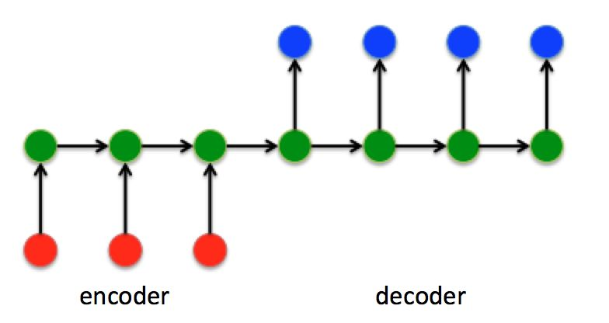
Sequence to Sequence Model (Seq2seq model)
Compared to normal RNN, Seq2Seq model has a structure no longer requiring the input and output sequences to have the same length. This is actually a great progress, for conversation in natural language hardly have sentences in a same length. The improved structure diagram is as follows：

Slide 22
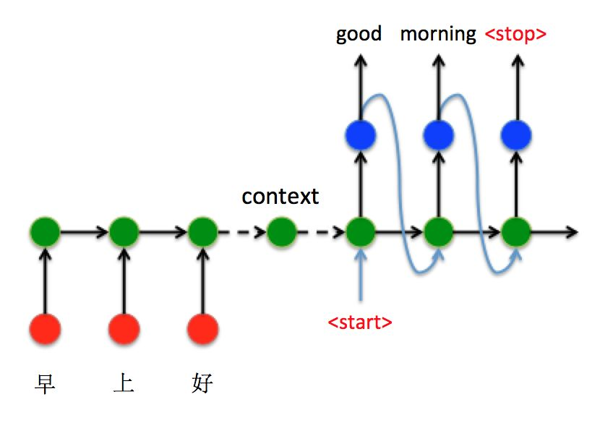
Sequence to Sequence Model (Seq2seq model)
We’d like to take machine translation applying Seq2Seq model as an example. Seq2Swq chatbot is of basically a same principle.

Slide 23
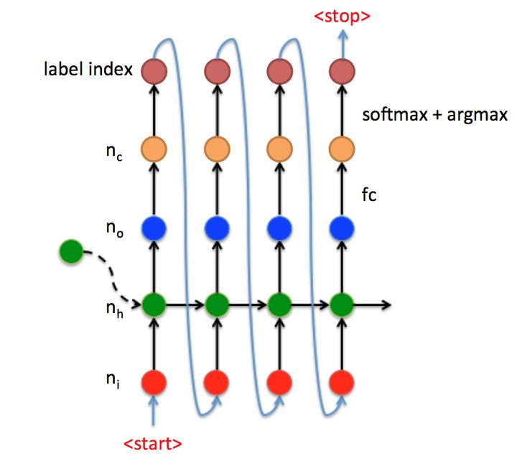
Sequence to Sequence Model (Seq2seq model)
Let’s have a look at the t time data stream at the Decoder side of the machine translation example above, as in Figure.
Note:
1.The vector [nt.1] of size xt (red dots) is input to the RNN.
2.The vector [n0,1] of size yt is outputted after the RNN (blue dots).
3.yt is transformed into a vector yt’ of size [nc,1] using fully-connected fc, where nc represents the number of categories.
4.yt is passed through softmax and argmax to obtain the category index, and then through int2str to obtain the output characters.
5.The category index is input to the next state until the <stop> flag is received to stop.

Slide 24
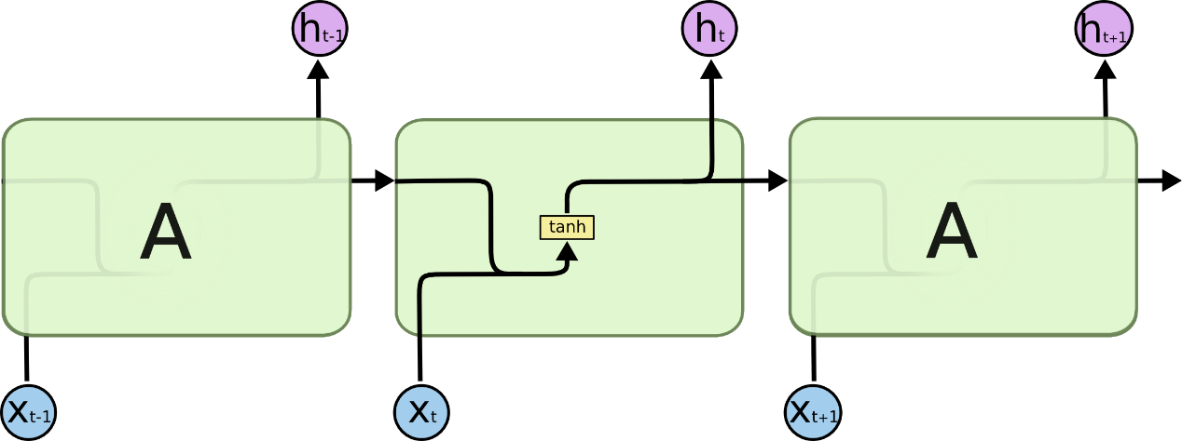
LSTM
LSTMs are explicitly designed to avoid the long-term dependency problem.
All recurrent neural networks have the form of a chain of repeating modules of neural network. In standard RNNs, this repeating module will have a very simple structure, such as a single tanh layer.

Slide 25

LSTM
The repeating module in a standard RNN contains a single layer.
LSTMs also have this chain like structure, but the repeating module has a different structure. Instead of having a single neural network layer, there are four, interacting in a very special way.

Slide 26
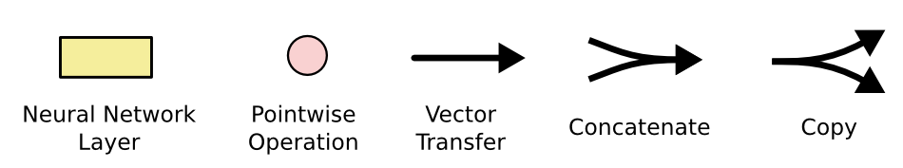
LSTM
In the left diagram, each line carries an entire vector, from the output of one node to the inputs of others. The pink circles represent pointwise operations, like vector addition, while the yellow boxes are learned neural network layers. Lines merging denote concatenation, while a line forking denote its content being copied and the copies going to different locations.

Slide 27
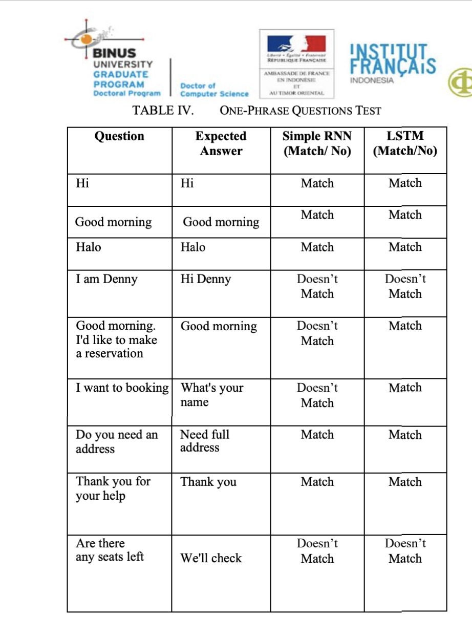
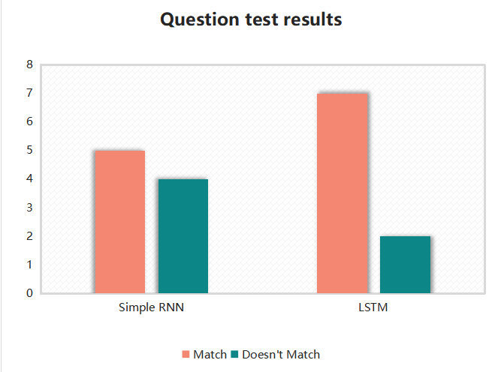
LSTM

Slide 28
Attention Mechanism
Before Bahdanau et al proposed the first Attention model in 2015, neural machine translation was based on encoder-decoder RNNs/LSTMs. Both encoder and decoder are stacks of LSTM/RNN units.

Slide 29
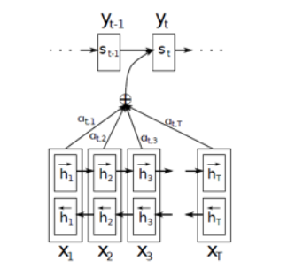
Attention Mechanism
Bahdanau et al (2015) came up with a simple but elegant idea where they suggested that not only can all the input words be taken into account in the context vector, but relative importance should also be given to each one of them.
So, whenever the proposed model generates a sentence, it searches for a set of positions in the encoder hidden states where the most relevant information is available. This idea is called ‘Attention’.

Slide 30

Attention Mechanism
The Bidirectional LSTM used here generates a sequence of annotations (h1, h2,….., hTx) for each input sentence. All the vectors h1,h2.., etc., used in their work are basically the concatenation of forward and backward hidden states in the encoder.

Slide 31

Attention Mechanism
Bahdanau put emphasis on embeddings of all the words in the input (represented by hidden states) while creating the context vector. They did this by simply taking a weighted sum of the hidden states.

Slide 32


Attention Mechanism
eij is the output score of a feedforward neural network described by the function a that attempts to capture the alignment between input at j and output at i.

Slide 33
Questions
1.What are the principles of these algorithms？
2.Why are we choosing these algorithms?
3.How would we apply them into our chatbot?

Slide 34
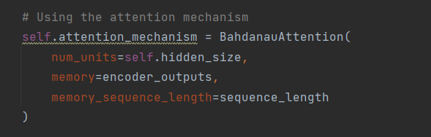
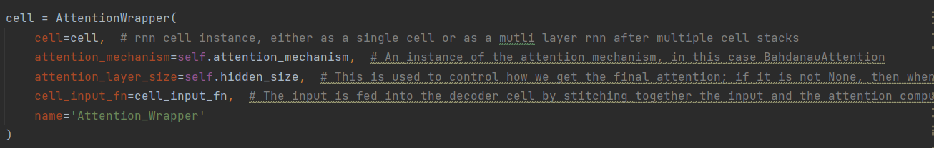

Slide 35
03
Part III

Slide 36
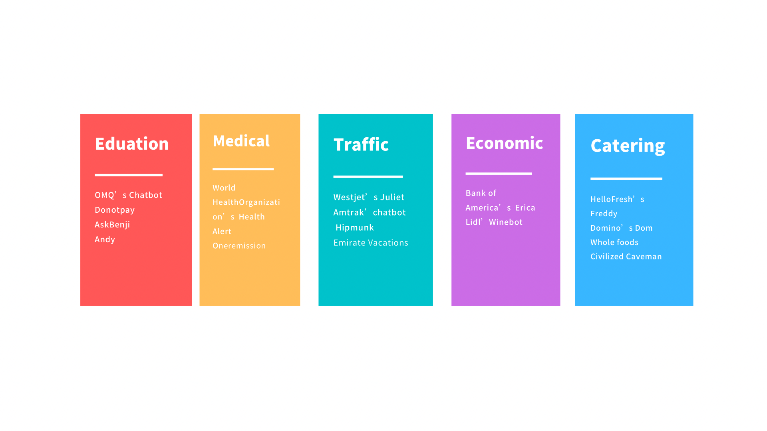
Application
In order to build a chatbot that will provide you with the information you need in the most concise way possible. So we found an existing chatbot with similar properties called Medwhat.

Slide 37
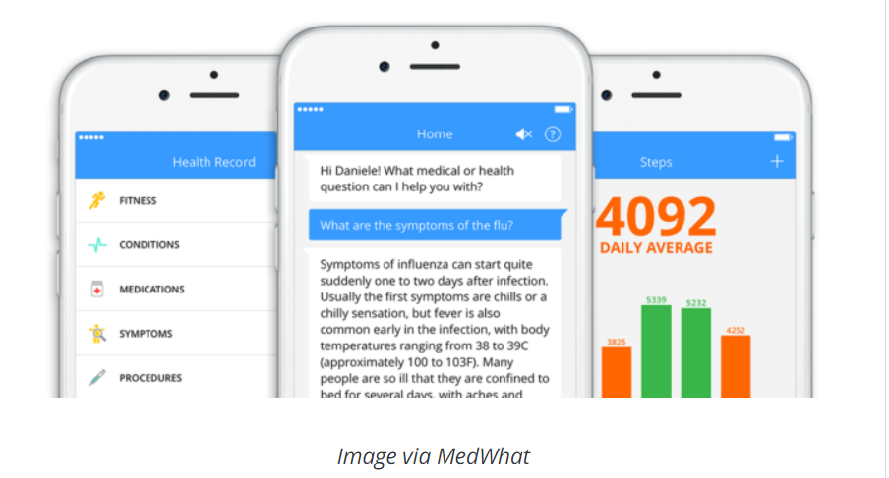
MedWhat
Medwhat is a chatbot actually inspired us on our idea to apply our project to share about preventive measures against COVID-19 and about vaccination. Medwhat answers medical and health questions for consumers and doctors instantly. The answers are provided by an intelligent super-computer that learns about medicine everyday and over time about your health record and medical questions history.

Slide 38
MedWhat
From its source, we analysis and summarize that:
1.its most state of the art NLP models today are based on attention mechanisms, specifically multi-layer self attention mechanisms. 2.MedWhat applies data science techniques to healthcare data stored in 2D medical images, 3D medical images, electronic health records, and wearable devices.

Slide 39
MedWhat
3.It also has some limitations:
•Large context and summarization are difficult
•Unidirectional training creates limitations
•Models have the biases from the corpora it was trained on
•Large and costly inference

Slide 40
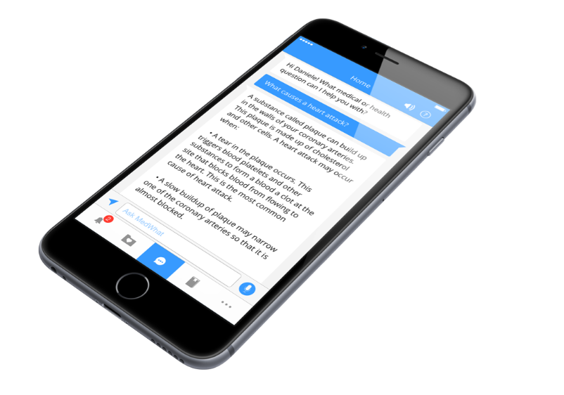
MedWhat
When we ask “What causes a heart attack?”, it can response A long list of answers.

Slide 41
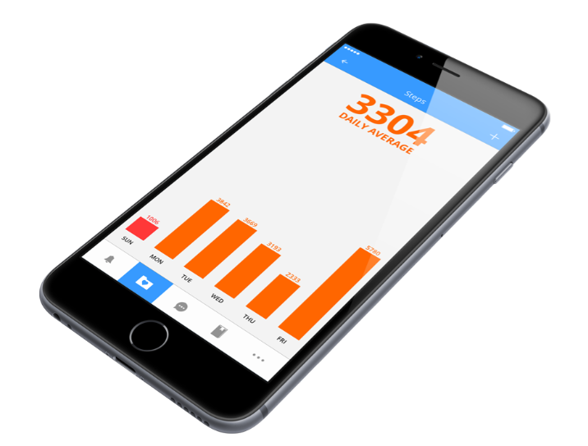
MedWhat
This figure is about the change in the number of cases in a country within a week, so maybe we can do like this to make the cases of COVID-19 visualized.

Slide 42
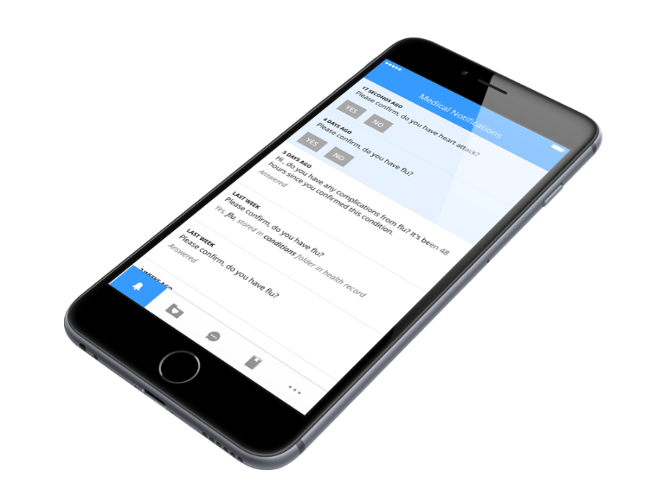
MedWhat
We can see It also have notifications for user. So we also can make notification for user like “What is the nearest hospital to this location?”, “No spicy food or alcohol for a fortnight after vaccination.”...

Slide 43
MedWhat
We hope to find out from chatbots in the same field how to use our technology and how to apply it to our chatbot, and we also hope that the users will have a better experience when using our chatbot once it is available in the market.

Slide 44
04
Reference

Slide 45
References
1. Abonia Sojasingarayar, Seq2Seq AI Chatbot with Attention Mechanism (2020)
2. Jurgita Kapociute-Dzikiene, A Domain-Specific Generative Chatbot Trained from Little Data (2020)
3. Kulothunkan Palasundram, Nurfadhlina Mohd Sharef. Norul Amelina Nashruddin, Khairul Azhar Kasmiran, Azreen Azman, Sequence to Sequence Model Performance for Education Chatbot (2019)
4. Yulius Denny Prabowo, Harco Leslie Hendric Spits Warnarrs, Widodo Budiharto, Achmad Imam Kistijantoro, Yaya Heryadi, Lukas, Lstm And Simple Rnn Comparison In The Problem Of Sequence To Sequence On Conversation Data Using Bahasa Indonesia (2018)
5. Panitan Muangkammuen, Narong Intiruk, Kanda Runapongsa Saikaew, Automatic Thai-FAQ Chatbot using RNN-LSTM (2021)
6. Ankil Shah, Bhargav Jain, Bhavin Agrawal, Saurabh Jain, Simon Shim, Problem Solving Chatbot for Data Structures (2018)
7. Yogi Wisesa Chandraa , Suyanto Suyanto, Indonesian Chatbot of University Admission Using a Question Answering System Based on Sequence-to-Sequence Model (2019)
8. Dan Shewan, 10 of the Most Innovative Chatbots on the web(2021)

Slide 46
References
9.Dzmitry Bahdanau, Kyunghyun cho, Yoshua Bengio, Neural Machine Translation by Jointly Learning to Align and Translate9[Submitted on 1 Sep 2014 (v1), last revised 19 May 2016 (this version, v7)]
10.Kyunghyun cho, Bart van Merrienboer, Caglare Gulcehre, Dzmitry Bahdanau, Fethi bougares, Holger Schwenk, Yoshua Bengio, Learning parase representations using RNN Encoder-Decoder for Statiscal Machine Translation[Submitted on 3 Jun 2014 (v1), last revised 3 Sep 2014 (this version, v3)]

Slide 47
WRITE A TITLE IN THIS SECTION
年终报告
Thanks
By faith I mean a vision of good one cherishes and the enthusiasm
that pushes one to seek its fulfillment regardless of obstacles.
设计师：梦想PPT 部门：营销部
Take good care yourself and stay safe

